Slide 1
Hadoop
SSE Qing Ding
dingqing@ustc.edu.cn

Slide 2

What Is ?
Distributed computing frame work
  For clusters of computers
  Thousands of Compute Nodes
  Petabytes of data
Open source, Java
Google’s MapReduce inspired Yahoo’s Hadoop.
Now part of Apache group

Slide 3
What Is ?
The Apache Hadoop project develops open-source software for reliable, scalable, distributed computing. Hadoop includes:
  Hadoop Common utilities
  Avro: A data serialization system with scripting languages.
  Chukwa: managing large distributed systems.
  HBase: A scalable, distributed database for large tables.
  HDFS: A distributed file system.
  Hive: data summarization and ad hoc querying.
  MapReduce: distributed processing on compute clusters.
  Pig: A high-level data-flow language for parallel computation.
  ZooKeeper: coordination service for distributed applications.

Slide 4
Component Overview

Slide 5
MapReduce v. Hadoop
 | MapReduce | Hadoop
Org | Google | Yahoo/Apache
Impl | C++ | Java
Distributed File Sys | GFS | HDFS
Data Base | Bigtable | HBase
Distributed lock mgr | Chubby | ZooKeeper

Slide 6
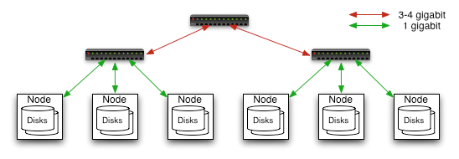
Commodity Hardware
Typically in 2 level architecture
– Nodes are commodity PCs
– 30-40 nodes/rack
– Uplink from rack is 3-4 gigabit
– Rack-internal is 1 gigabit

Slide 7
Goals of HDFS
Very Large Distributed File System
– 10K nodes, 100 million files, 10 PB
Assumes Commodity Hardware
– Files are replicated to handle hardware failure
– Detect failures and recovers from them
Optimized for Batch Processing
– Data locations exposed so that computations can move to where data resides
– Provides very high aggregate bandwidth
User Space, runs on heterogeneous OS

Slide 8
HDFS Architecture
Cluster Membership
NameNode
1. filename
2. BlckId, DataNodes
o
Secondary
NameNode
Client
3.Read data
Cluster Membership
NameNode : Maps a file to a file-id and list of MapNodes
DataNode : Maps a block-id to a physical location on disk
SecondaryNameNode: Periodic merge of Transaction log
DataNodes

Slide 9
Distributed File System
Single Namespace for entire cluster
Data Coherency
– Write-once-read-many access model
– Client can only append to existing files
Files are broken up into blocks
– Typically 128 MB block size
– Each block replicated on multiple DataNodes
Intelligent Client
– Client can find location of blocks
– Client accesses data directly from DataNode

Slide 10
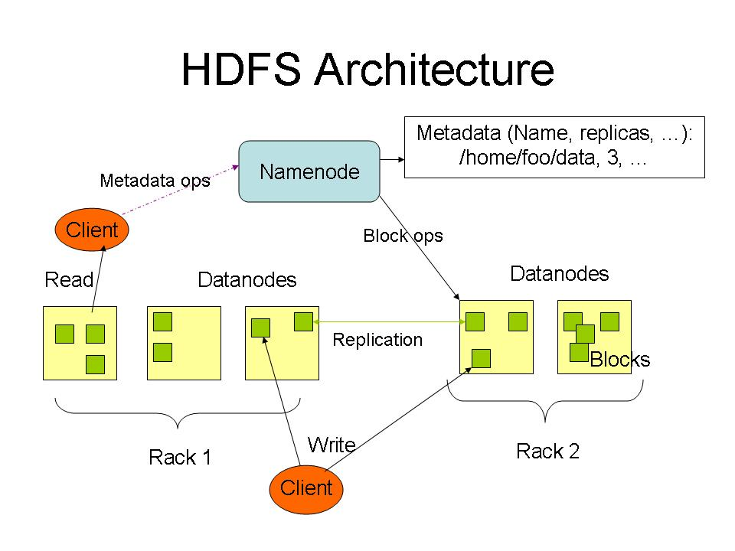

Slide 11
NameNode Metadata
Meta-data in Memory
– The entire metadata is in main memory
– No demand paging of meta-data
Types of Metadata
– List of files
– List of Blocks for each file
– List of DataNodes for each block
– File attributes, e.g creation time, replication factor
A Transaction Log
– Records file creations, file deletions. etc

Slide 12
DataNode
A Block Server
– Stores data in the local file system (e.g. ext3)
– Stores meta-data of a block (e.g. CRC)
– Serves data and meta-data to Clients
Block Report
– Periodically sends a report of all existing blocks to the NameNode
Facilitates Pipelining of Data
– Forwards data to other specified DataNodes

Slide 13
Block Placement
Current Strategy
-- One replica on local node
-- Second replica on a remote rack
-- Third replica on same remote rack
-- Additional replicas are randomly placed
Clients read from nearest replica
Would like to make this policy pluggable

Slide 14
Data Correctness
Use Checksums to validate data
– Use CRC32
File Creation
– Client computes checksum per 512 byte
– DataNode stores the checksum
File access
– Client retrieves the data and checksum from DataNode
– If Validation fails, Client tries other replicas

Slide 15
NameNode Failure
A single point of failure
Transaction Log stored in multiple directories
– A directory on the local file system
– A directory on a remote file system (NFS/CIFS)
Need to develop a real HA solution

Slide 16
Data Pipelining
Client retrieves a list of DataNodes on which to place replicas of a block
Client writes block to the first DataNode
The first DataNode forwards the data to the next DataNode in the Pipeline
When all replicas are written, the Client moves on to write the next block in file

Slide 17
Rebalancer
Goal: % disk full on DataNodes should be similar
  Usually run when new DataNodes are added
  Cluster is online when Rebalancer is active
  Rebalancer is throttled to avoid network congestion
  Command line tool

Slide 18
The Idea of Map Reduce

Slide 19
Map and Reduce
The idea of Map, and Reduce is 40+ year old
  Present in all Functional Programming Languages.
  See, e.g., APL, Lisp and ML
Alternate names for Map: Apply-All
Higher Order Functions
  take function definitions as arguments, or
  return a function as output
Map and Reduce are higher-order functions.

Slide 20
Map: A Higher Order Function
F(x: int) returns r: int
Let V be an array of integers.
W = map(F, V)
  W[i] = F(V[i]) for all I
  i.e., apply F to every element of V

Slide 21
Map Examples in Haskell
map (+1) [1,2,3,4,5]
== [2, 3, 4, 5, 6]
map (toLower) "abcDEFG12!@#“
== "abcdefg12!@#“
map (`mod` 3) [1..10]
== [1, 2, 0, 1, 2, 0, 1, 2, 0, 1]

Slide 22
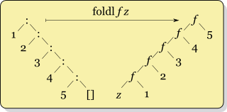
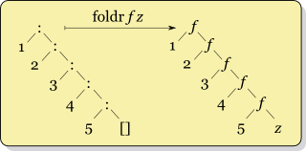
reduce: A Higher Order Function
reduce also known as fold, accumulate, compress or inject
Reduce/fold takes in a function and folds it in between the elements of a list.

Slide 23
Fold-Left in Haskell
Definition
  foldl f z [] = z
  foldl f z (x:xs) = foldl f (f z x) xs
Examples
  foldl (+) 0 [1..5] ==15
  foldl (+) 10 [1..5] == 25
  foldl (div) 7 [34,56,12,4,23] == 0

Slide 24
Fold-Right in Haskell
Definition
  foldr f z [] = z
  foldr f z (x:xs) = f x (foldr f z xs)
Example
  foldr (div) 7 [34,56,12,4,23] == 8

Slide 25
Examples of the
Map Reduce Idea

Slide 26
Word Count Example
Read text files and count how often words occur.
  The input is text files
  The output is a text file
    each line: word, tab, count
Map: Produce pairs of (word, count)
Reduce: For each word, sum up the counts.

Slide 27
Grep Example
Search input files for a given pattern
Map: emits a line if pattern is matched
Reduce: Copies results to output

Slide 28
Inverted Index Example
Generate an inverted index of words from a given set of files
Map: parses a document and emits <word, docId> pairs
Reduce: takes all pairs for a given word, sorts the docId values, and emits a <word, list(docId)> pair

Slide 29
Map/Reduce Implementation Idea

Slide 30
Execution on Clusters
Input files split (M splits)
Assign Master & Workers
Map tasks
Writing intermediate data to disk (R regions)
Intermediate data read & sort
Reduce tasks
Return

Slide 31


Map/Reduce Cluster Implementation
Input files
M map tasks
Intermediate files
R reduce tasks
Output files
split 0
split 1
split 2
split 3
split 4
Output 0
Output 1
Several map or reduce tasks can run on a single computer
Each intermediate file is divided into R partitions, by partitioning function
Each reduce task corresponds to one partition

Slide 32
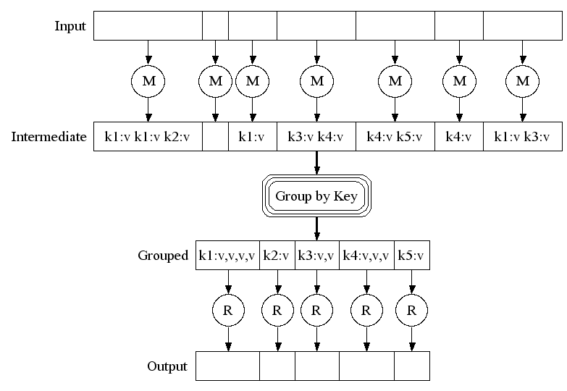
Execution

Slide 33
Fault Recovery
Workers are pinged by master periodically
  Non-responsive workers are marked as failed
  All tasks in-progress or completed by failed worker become eligible for rescheduling
Master could periodically checkpoint
  Current implementations abort on master failure

Slide 34
wordCount
A Simple Hadoop Example
http://wiki.apache.org/hadoop/WordCount

Slide 35
Word Count Example
Read text files and count how often words occur.
  The input is text files
  The output is a text file
    each line: word, tab, count
Map: Produce pairs of (word, count)
Reduce: For each word, sum up the counts.

Slide 36
WordCount Overview
3 import ...
12 public class WordCount {
13
14 public static class Map extends MapReduceBase implements Mapper ... {
17
18 public void map ...
26 }
27
28 public static class Reduce extends MapReduceBase implements Reducer ... {
29
30 public void reduce ...
37 }
38
39 public static void main(String[] args) throws Exception {
40 JobConf conf = new JobConf(WordCount.class);
41 ...
53 FileInputFormat.setInputPaths(conf, new Path(args[0]));
54 FileOutputFormat.setOutputPath(conf, new Path(args[1]));
55
56 JobClient.runJob(conf);
57 }
58
59 }

Slide 37
wordCount Mapper
14 public static class Map extends MapReduceBase implements Mapper<LongWritable, Text, Text, IntWritable> {
15 private final static IntWritable one = new IntWritable(1);
16 private Text word = new Text();
17
18 public void map(
LongWritable key, Text value,
OutputCollector<Text, IntWritable> output,
Reporter reporter)
throws IOException {
19 String line = value.toString();
20 StringTokenizer tokenizer = new StringTokenizer(line);
21 while (tokenizer.hasMoreTokens()) {
22 word.set(tokenizer.nextToken());
23 output.collect(word, one);
24 }
25 }
26 }

Slide 38
wordCount Reducer
28 public static class Reduce extends MapReduceBase implements Reducer<Text, IntWritable, Text, IntWritable> {
29
30 public void reduce(Text key, Iterator<IntWritable> values, OutputCollector<Text, IntWritable> output,
Reporter reporter)
throws IOException {
31 int sum = 0;
32 while (values.hasNext()) {
33 sum += values.next().get();
34 }
35 output.collect(key, new IntWritable(sum));
36 }
37 }

Slide 39
wordCount JobConf
40 JobConf conf = new JobConf(WordCount.class);
41 conf.setJobName("wordcount");
42
43 conf.setOutputKeyClass(Text.class);
44 conf.setOutputValueClass(IntWritable.class);
45
46 conf.setMapperClass(Map.class);
47 conf.setCombinerClass(Reduce.class);
48 conf.setReducerClass(Reduce.class);
49
50 conf.setInputFormat(TextInputFormat.class);
51 conf.setOutputFormat(TextOutputFormat.class);

Slide 40
WordCount main
39 public static void main(String[] args) throws Exception {
40 JobConf conf = new JobConf(WordCount.class);
41 conf.setJobName("wordcount");
42
43 conf.setOutputKeyClass(Text.class);
44 conf.setOutputValueClass(IntWritable.class);
45
46 conf.setMapperClass(Map.class);
47 conf.setCombinerClass(Reduce.class);
48 conf.setReducerClass(Reduce.class);
49
50 conf.setInputFormat(TextInputFormat.class);
51 conf.setOutputFormat(TextOutputFormat.class);
52
53 FileInputFormat.setInputPaths(conf, new Path(args[0]));
54 FileOutputFormat.setOutputPath(conf, new Path(args[1]));
55
56 JobClient.runJob(conf);
57 }

Slide 41
Invocation of wordcount
/usr/local/bin/hadoop dfs -mkdir <hdfs-dir>
/usr/local/bin/hadoop dfs -copyFromLocal <local-dir> <hdfs-dir>
/usr/local/bin/hadoop
jar hadoop-*-examples.jar
wordcount
[-m <#maps>]
[-r <#reducers>]
<in-dir>
<out-dir>

Slide 42
Mechanics of Programming Hadoop Jobs

Slide 43
Job Launch: Client
Client program creates a JobConf
  Identify classes implementing Mapper and Reducer interfaces
    setMapperClass(), setReducerClass()
  Specify inputs, outputs
    setInputPath(), setOutputPath()
  Optionally, other options too:
    setNumReduceTasks(), setOutputFormat()…

Slide 44
Job Launch: JobClient
Pass JobConf to
  JobClient.runJob() // blocks
  JobClient.submitJob() // does not block
JobClient:
  Determines proper division of input into InputSplits
  Sends job data to master JobTracker server

Slide 45
Job Launch: JobTracker
JobTracker:
  Inserts jar and JobConf (serialized to XML) in shared location
  Posts a JobInProgress to its run queue

Slide 46
Job Launch: TaskTracker
TaskTrackers running on slave nodes periodically query JobTracker for work
Retrieve job-specific jar and config
Launch task in separate instance of Java
  main() is provided by Hadoop

Slide 47
Job Launch: Task
TaskTracker.Child.main():
  Sets up the child TaskInProgress attempt
  Reads XML configuration
  Connects back to necessary MapReduce components via RPC
  Uses TaskRunner to launch user process

Slide 48
Job Launch: TaskRunner
TaskRunner, MapTaskRunner, MapRunner work in a daisy-chain to launch Mapper
  Task knows ahead of time which InputSplits it should be mapping
  Calls Mapper once for each record retrieved from the InputSplit
Running the Reducer is much the same

Slide 49
Creating the Mapper
Your instance of Mapper should extend MapReduceBase
One instance of your Mapper is initialized by the MapTaskRunner for a TaskInProgress
  Exists in separate process from all other instances of Mapper – no data sharing!

Slide 50
Mapper
void map (
WritableComparable key,
Writable value,
OutputCollector output,
Reporter reporter
)

Slide 51
What is Writable?
Hadoop defines its own “box” classes for strings (Text), integers (IntWritable), etc.
All values are instances of Writable
All keys are instances of WritableComparable

Slide 52
Writing For Cache Coherency
while (more input exists) {
myIntermediate = new intermediate(input);
myIntermediate.process();
export outputs;
}

Slide 53
Writing For Cache Coherency
myIntermediate = new intermediate (junk);
while (more input exists) {
myIntermediate.setupState(input);
myIntermediate.process();
export outputs;
}

Slide 54
Writing For Cache Coherency
Running the GC takes time
Reusing locations allows better cache usage
Speedup can be as much as two-fold
All serializable types must be Writable anyway, so make use of the interface

Slide 55
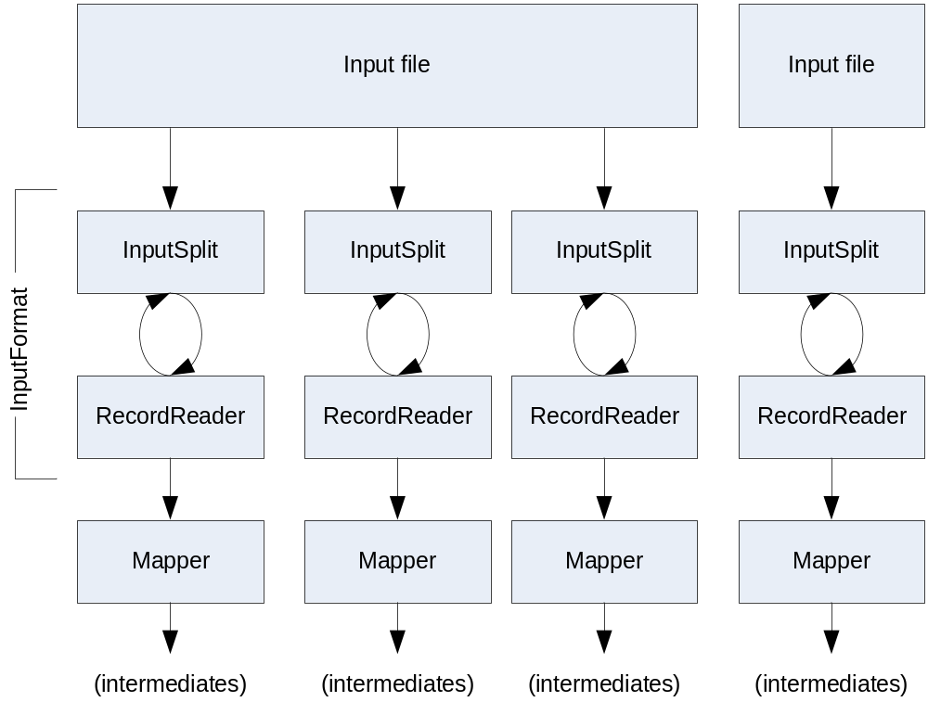
Getting Data To The Mapper

Slide 56
Reading Data
Data sets are specified by InputFormats
  Defines input data (e.g., a directory)
  Identifies partitions of the data that form an InputSplit
  Factory for RecordReader objects to extract (k, v) records from the input source

Slide 57
FileInputFormat and Friends
TextInputFormat
  Treats each ‘\n’-terminated line of a file as a value
KeyValueTextInputFormat
  Maps ‘\n’- terminated text lines of “k SEP v”
SequenceFileInputFormat
  Binary file of (k, v) pairs with some add’l metadata
SequenceFileAsTextInputFormat
  Same, but maps (k.toString(), v.toString())

Slide 58
Filtering File Inputs
FileInputFormat will read all files out of a specified directory and send them to the mapper
Delegates filtering this file list to a method subclasses may override
  e.g., Create your own “xyzFileInputFormat” to read *.xyz from directory list

Slide 59
Record Readers
Each InputFormat provides its own RecordReader implementation
  Provides (unused?) capability multiplexing
LineRecordReader
  Reads a line from a text file
KeyValueRecordReader
  Used by KeyValueTextInputFormat

Slide 60
Input Split Size
FileInputFormat will divide large files into chunks
  Exact size controlled by mapred.min.split.size
RecordReaders receive file, offset, and length of chunk
Custom InputFormat implementations may override split size
  e.g., “NeverChunkFile”

Slide 61
Sending Data To Reducers
Map function receives OutputCollector object
  OutputCollector.collect() takes (k, v) elements
Any (WritableComparable, Writable) can be used

Slide 62
WritableComparator
Compares WritableComparable data
  Will call WritableComparable.compare()
  Can provide fast path for serialized data
JobConf.setOutputValueGroupingComparator()

Slide 63
Sending Data To The Client
Reporter object sent to Mapper allows simple asynchronous feedback
  incrCounter(Enum key, long amount)
  setStatus(String msg)
Allows self-identification of input
  InputSplit getInputSplit()

Slide 64
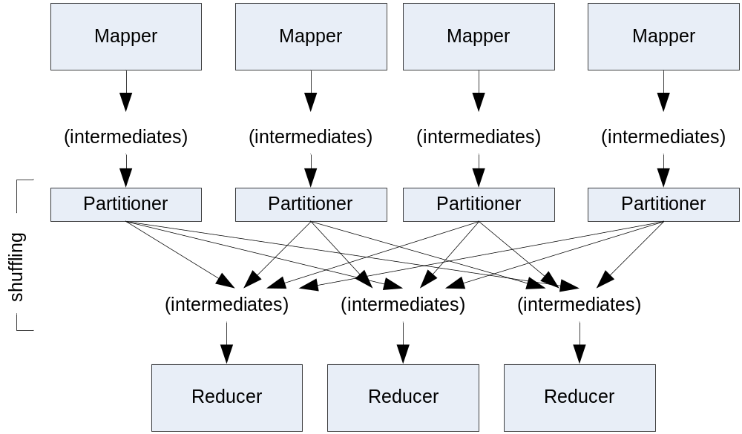
Partition And Shuffle

Slide 65
Partitioner
int getPartition(key, val, numPartitions)
  Outputs the partition number for a given key
  One partition == values sent to one Reduce task
HashPartitioner used by default
  Uses key.hashCode() to return partition num
JobConf sets Partitioner implementation

Slide 66
Reduction
reduce( WritableComparable key,
  Iterator values,
  OutputCollector output,
  Reporter reporter)
Keys & values sent to one partition all go to the same reduce task
Calls are sorted by key – “earlier” keys are reduced and output before “later” keys

Slide 67
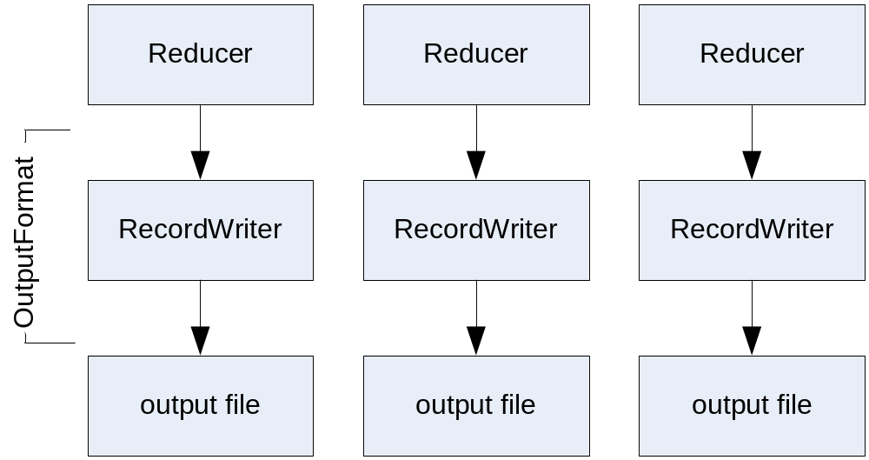
Finally: Writing The Output

Slide 68
OutputFormat
Analogous to InputFormat
TextOutputFormat
  Writes “key val\n” strings to output file
SequenceFileOutputFormat
  Uses a binary format to pack (k, v) pairs
NullOutputFormat
  Discards output

Slide 69
HDFS

Slide 70
HDFS Limitations
“Almost” GFS (Google FS)
  No file update options (record append, etc); all files are write-once
Does not implement demand replication
Designed for streaming
  Random seeks devastate performance

Slide 71
NameNode
“Head” interface to HDFS cluster
Records all global metadata

Slide 72
Secondary NameNode
Not a failover NameNode!
Records metadata snapshots from “real” NameNode
  Can merge update logs in flight
  Can upload snapshot back to primary

Slide 73
NameNode Death
No new requests can be served while NameNode is down
  Secondary will not fail over as new primary
So why have a secondary at all?

Slide 74
NameNode Death, cont’d
If NameNode dies from software glitch, just reboot
But if machine is hosed, metadata for cluster is irretrievable!

Slide 75
Bringing the Cluster Back
If original NameNode can be restored, secondary can re-establish the most current metadata snapshot
If not, create a new NameNode, use secondary to copy metadata to new primary, restart whole cluster ( ☹ )
Is there another way…?

Slide 76
Keeping the Cluster Up
Problem: DataNodes “fix” the address of the NameNode in memory, can’t switch in flight
Solution: Bring new NameNode up, but use DNS to make cluster believe it’s the original one

Slide 77
Further Reliability Measures
Namenode can output multiple copies of metadata files to different directories
  Including an NFS mounted one
  May degrade performance; watch for NFS locks

Slide 78
Making Hadoop Work
Basic configuration involves pointing nodes at master machines
  mapred.job.tracker
  fs.default.name
  dfs.data.dir, dfs.name.dir
  hadoop.tmp.dir
  mapred.system.dir
See “Hadoop Quickstart” in online documentation

Slide 79
Configuring for Performance
Configuring Hadoop performed in “base JobConf” in conf/hadoop-site.xml
Contains 3 different categories of settings
  Settings that make Hadoop work
  Settings for performance
  Optional flags/bells & whistles

Slide 80
Configuring for Performance
mapred.child.java.opts | -Xmx512m
dfs.block.size | 134217728
mapred.reduce.parallel.copies | 20—50
dfs.datanode.du.reserved | 1073741824
io.sort.factor | 100
io.file.buffer.size | 32K—128K
io.sort.mb | 20--200
tasktracker.http.threads | 40—50

Slide 81
Number of Tasks
Controlled by two parameters:
  mapred.tasktracker.map.tasks.maximum
  mapred.tasktracker.reduce.tasks.maximum
Two degrees of freedom in mapper run time: Number of tasks/node, and size of InputSplits
Current conventional wisdom: 2 map tasks/core, less for reducers
See http://wiki.apache.org/lucene-hadoop/HowManyMapsAndReduces

Slide 82
Dead Tasks
Student jobs would “run away”, admin restart needed
Very often stuck in huge shuffle process
  Students did not know about Partitioner class, may have had non-uniform distribution
  Did not use many Reducer tasks
  Lesson: Design algorithms to use Combiners where possible

Slide 83
Working With the Scheduler
Remember: Hadoop has a FIFO job scheduler
  No notion of fairness, round-robin
Design your tasks to “play well” with one another
  Decompose long tasks into several smaller ones which can be interleaved at Job level

Slide 84
Additional Languages & Components

Slide 85
Hadoop and C++
Hadoop Pipes
  Library of bindings for native C++ code
  Operates over local socket connection
Straight computation performance may be faster
Downside: Kernel involvement and context switches

Slide 86
Hadoop and Python
Option 1: Use Jython
  Caveat: Jython is a subset of full Python
Option 2: HadoopStreaming

Slide 87
HadoopStreaming
Effectively allows shell pipe ‘|’ operator to be used with Hadoop
You specify two programs for map and reduce
  (+) stdin and stdout do the rest
  (-) Requires serialization to text, context switches…
  (+) Reuse Linux tools: “cat | grep | sort | uniq”

Slide 88
Eclipse Plugin
Support for Hadoop in Eclipse IDE
  Allows MapReduce job dispatch
  Panel tracks live and recent jobs
http://www.alphaworks.ibm.com/tech/mapreducetools

Slide 89
Useful Links
HDFS Design:
  http://hadoop.apache.org/core/docs/current/hdfs_design.html
Hadoop API:
  http://hadoop.apache.org/core/docs/current/api/
Hive:
  http://hadoop.apache.org/hive/

